Slide 1


Canada’s Net-Zero Story
Net-Zero Statistics Sprint
2025.08.21
UN Network of Economic Statisticians

Slide 2
Points of Discussion
01
Net-Zero and Milestone Targets
03
Indicator Gaps
02
Measuring Progress
04
What's Next

Slide 3


Canadian Net-Zero Emissions Accountability Act (CNZEAA)
Canada’s
Net-Zero Target
Adopted in 2021.
Enshrines Canada’s commitment to achieve net zero by 2050 in legislation.
Defines net zero as follows: anthropogenic emissions of greenhouse gases into the atmosphere are balanced by anthropogenic removals of greenhouse gases from the atmosphere over a specified period.
Ensures transparency and accountability as the government works to deliver on its targets. The Act requires public participation and independent advice to guide the Government of Canada’s efforts.
Codifies the process for setting national targets to reduce GHG emissions in support of achieving net-zero emissions by 2050.

Slide 4

Canadian Net-Zero Emissions Accountability Act
Target Setting
Emissions Reduction Plan
Progress Report
Reporting Requirements
Assessment Report
Net-Zero Advisory Body (NZAB) Annual Reports and
Minister’s Response​
Annual Reports​ on Climate-Related Financial Risk Management
Commissioner of the Environment and Sustainable
Development (CESD) Audits​

Slide 5



Setting National Targets Under CNZEAA
Milestones Years and Progression
•A national GHG emissions target must be set for each milestone year (2030, 2035, 2040, 2045) with a view to achieving net-zero emissions by 2050.
•Subsequent targets must be set at least ten years in advance and must represent a progression beyond the previous one, and be as ambitous as the most recent NDC.
Consultation
•Provinces, territories, Indigenous Peoples, Net-Zero Advisory Body, and interested persons must have the opportunity to provide submissions.
Factors to consider
•The Minister of the Environment must take the following into account: best available science, Indigenous knowledge, submission by the Net-Zero Advisory Body (NZAB), international commitments.
By 2030: 40-45% below 2005 levels
By 2035: 45-50% below 2005 levels
The NZAB is mandated to provide independent advice to the Minister with respect to achieving net-zero emissions by 2050, including advice on GHG emissions targets and GHG reduction plans

Slide 6
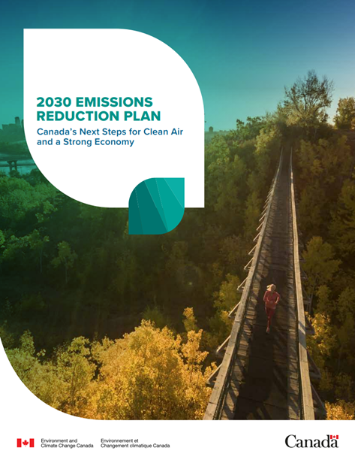
Towards Net Zero:
Emissions
Reduction Plans (ERP)
Required under CNZEAA, at least 5 years in advance of the relevant milestone year
2030 ERP was released in March 2022; Includes a 2026 interim objective of 20% below 2005 levels
A sector-by-sector roadmap, with the federal measures needed (140+) for Canada to reach its 2030 target, and putting in place the building blocks for net-zero emissions by 2050
Three Progress Reports (2023, 2025 and 2027), which serve as check-ins on progress made on 2030 ERP commitments
2035 ERP must be published by the end of 2029

Slide 7
REGULATIONS
Strengthened methane regulations for oil and gas
Landfill Methane Emissions Regulations
Regulated light‑duty zero‑emission vehicle sales targets
Some of Canada’s Key Measures
FINANCIAL INCENTIVES
Strategic Innovation Fund – Net Zero Accelerator
Canada Infrastructure Bank
Clean Economy investment tax credits, e.g., for Carbon Capture, Utilization, and Storage
Low Carbon Economy Fund
Nature Smart Climate Solutions Fund
National Housing Strategy
CARBON PRICING
Carbon Pollution Pricing for Industry - Output-Based Pricing System

Slide 8

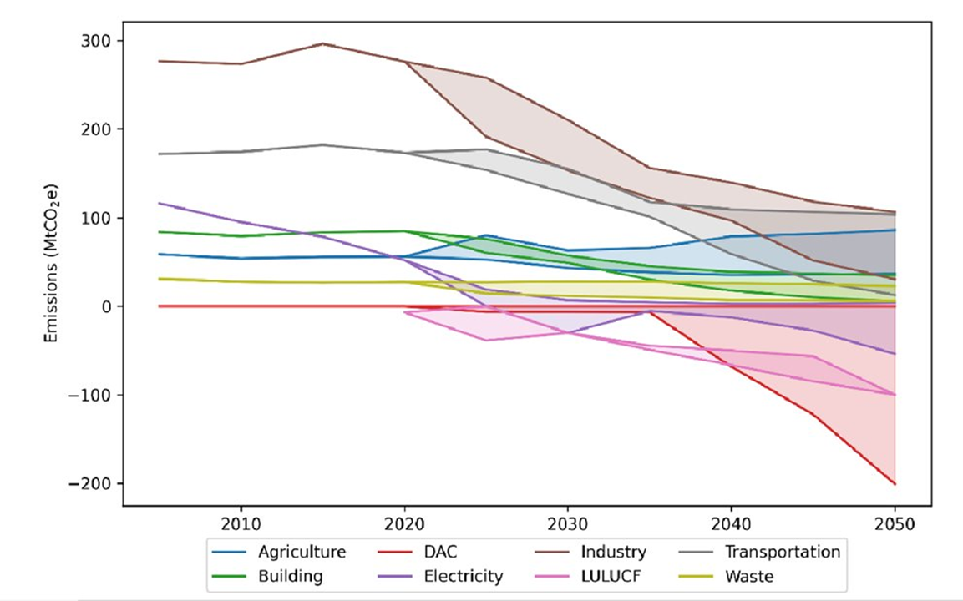
Canada’s Long-Term Strategy
Canada Emissions (2005-2050) - All scenarios
Submitted to the UNFCCC in October 2022, the LTS explores illustrative scenarios for Canada to achieve net-zero emissions by 2050.
There are numerous pathways with a wide range of possibilities to achieving net-zero emissions in Canada.
Key enabling conditions, such as renewable energy, electrification, and energy efficiency, play a key role in each scenario for Canada to achieve net-zero emissions.
Notes:
The pathway each sector takes to 2050 in all modelled scenarios is shown in the Figure, with shaded parts representing the bands in emission pathways. As seen in the figure, there are numerous pathways with a wide range of possibilities to achieving net-zero emissions in Canada. While these bands in emission pathways do not represent an exhaustive list of possible pathways, they are helpful in identifying general trends.
Scenario 1: Current Assumptions: based on today’s (2022) understanding of the costs and constraints of achieving net-zero emissions
Scenario 2: High Electrification: shows widespread electrification across all sectors of the economy
Scenario 3: High Use of Renewable and Alternative Fuels: increased use of renewable and alternative fuels, such as low-carbon hydrogen and bioenergy fuels; resources like hydrogen complement widespread electrification, particularly in the harder-to-electrify areas of industry, as well as heavy-duty transport, such as aviation, freight trucks, and shipping
Scenario 4: High Use of Engineered CO2 Removal Technologies: explores the impact of more rapid technological change and a greater use of carbon capture technologies, including CCS and DAC. This scenario assumes that CO2 removal technologies become more affordable and cost-effective, leading to an increased deployment in various industry sectors, electricity generation, and the oil and gas sector

Slide 9

Measuring Progress
A collaborative work between 14 federal departments/agencies/crown corporations
Natural Resources Canada
Canada Infrastructure Bank
Innovation, Science and Economic Development Canada
Crown-Indigenous Relations and Northern Affairs Canada
National Research Council Canada
Agriculture and Agri-Food Canada
Environment and Climate Change Canada
(Lead coordinator)
Statistics Canada
Transport Canada
Housing, Infrastructure and Communities Canada
Public Services and Procurement Canada
Finance Canada
Indigenous Services Canada
Treasury Board of Canada Secretariat

Slide 10

Canada’s National Statistical Office - Statistics Canada
Provides Environment and Climate Change Canada with a large portion of the underlying activity data for estimating the GHG emissions in the Energy and the Industrial Processes and Product Use (IPPU) sectors
Responsible for the collection, compilation, and dissemination of Canada’s energy balance in its annual Report on Energy Supply and Demand in Canada.
Collects other energy data from the mining and electricity industries as well as production data from other non-energy-related industries, including petrochemical industries and mineral resources.
Key data source used to estimate fuel combustion emissions for space heating to electricity generation and industrial, manufacturing and transportation activities.
In addition, it compiles activity data on agriculture (crops, crop production and management practices through the Census of Agriculture), and livestock populations.
The energy balance utilises a number of Statistics Canada surveys, including, among others, the annual Industrial Consumption of Energy (ICE) survey, which collects energy consumption data from various industries.

Slide 11
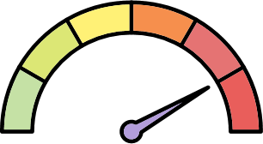
Measuring Progress
Reported in the Progress Reports on the ERP (domestically) and Biennial Transparency Reports and National Communications (internationally)
Mitigation Policies and Measures
Historical GHG Emissions
Projected GHG Emissions
GHG Intensity
Update on the ratio of GHG emissions and unit of GDP, to indicate how closely linked emissions are to economic growth.
Measure-by-measure update on the implementation status of federal measures (ERP Progress Report) and Federal-Provincial-Territorial measures (BTR).
Update based on Canada’s most recent inventory of historical emissions (April 2025, data up to 2023).
Update based on Canada’s most recent emissions projections (December 2024, data up to 2040).

Slide 12
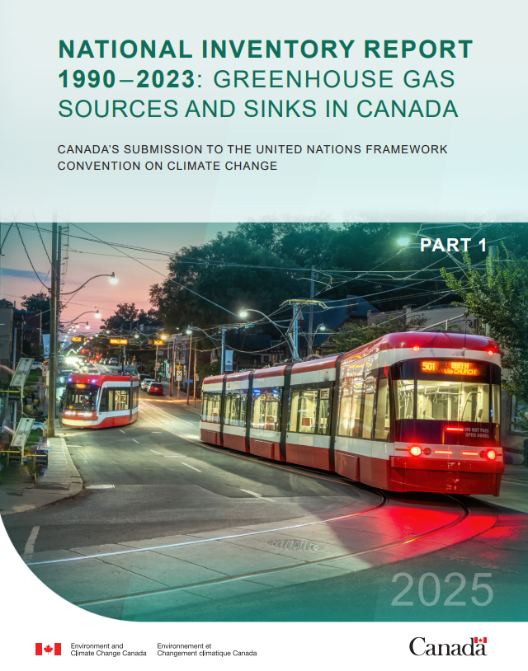

Canada’s National Inventory Report
Produces all estimates at national, provincial and territorial (PT) levels
Partnerships between federal departments (Environment and Climate Change Canada (ECCC), Statistics Canada, Natural Resources Canada, Agriculture and Agri-Food Canada), arrangements with industry associations, consultants, universities, collaborative bilateral agreements with PTs
Provinces and territories:
•Preliminary estimates and material are shared
•Different estimation approach for each sector
Many sectors are estimated at PT level
Others are estimated at national level and then, distributed
Emissions estimates by economic sector (in addition to IPCC)
GHG Reporting Program: consists of GHG emissions from on-site activities reported by individual facilities (n=1,837)

Slide 13


Canada’s GHG Emissions Projections
To provide a better understanding of the level of effort Canada would need to deploy to reach its climate targets.
How:
  Using the Energy, Emissions and Economy Model for Canada (E3MC), a detailed, proven energy, emissions, and economy model for Canada.
Projections are developed in line with generally recognized practices and according to guidelines adopted by the United Nations Framework Convention on Climate Change (UNFCCC).
  Using the most up-to-date statistics on GHG emissions and energy use, and sourcing key assumptions from the best available public and private expert sources.
  Aggregating and reporting results from external models to account for the accounting contribution of the LULUCF sector.
Developed by ECCC in collaboration with other federal departments such as Natural Resources Canada, Agriculture and Agri-Food Canada, Transport Canada, Statistics Canada, Finance Canada, and the Canada Energy Regulator, as well as provinces and territories.

Slide 14
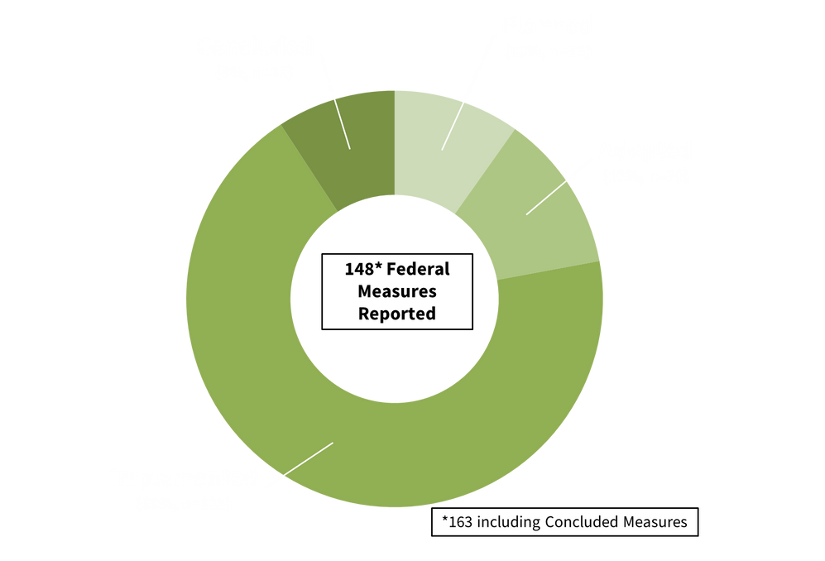
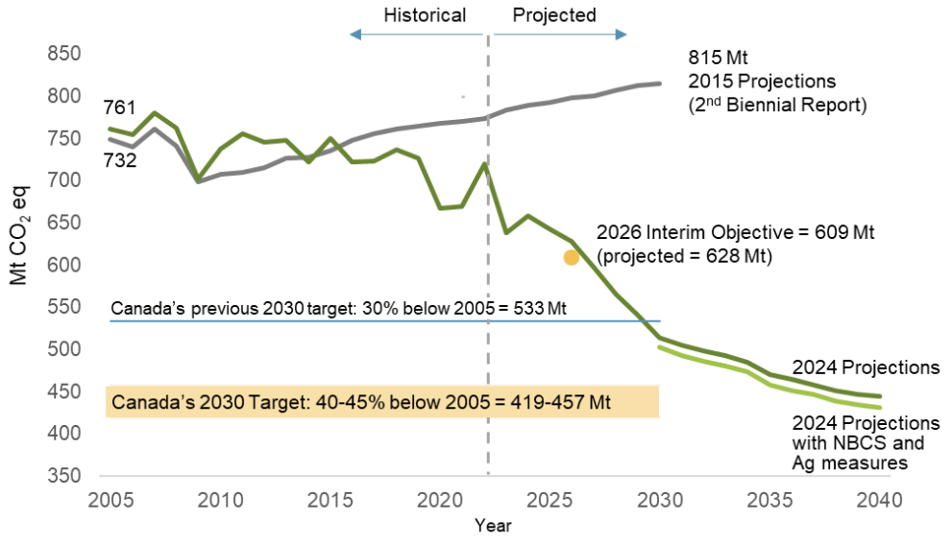
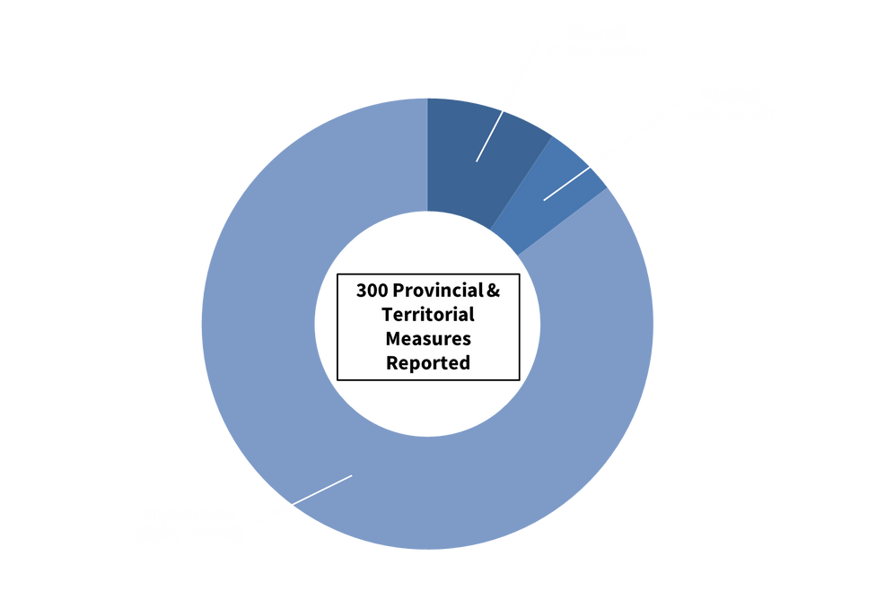
Canada’s Road Towards 2030
Policies and Measures
Total Canadian GHG Emissions (Including LULUCF) to 2040 (Mt CO2 eq)
In 2022, Canada emitted 708 Mt CO2 eq or 7.1% below 2005 levels (5.5% below when including the LULUCF accounting contribution)
In 2023, Canada emitted 694 Mt CO2 eq or 8.5% below 2005 levels (excluding LULUCF)
Estimated reduction to 502 Mt by 2030 or 34% below 2005 levels

Slide 15
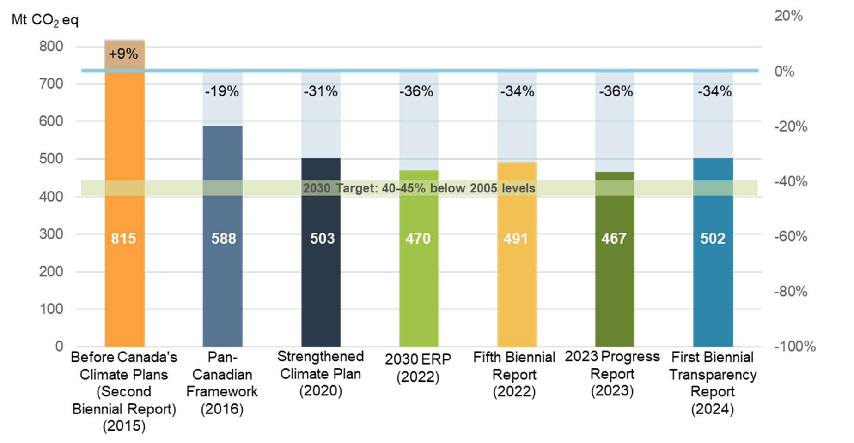
Canada’s Road Towards 2030
Progression of Canada's projected emissions in 2030 (Mt CO2 eq)

Slide 16
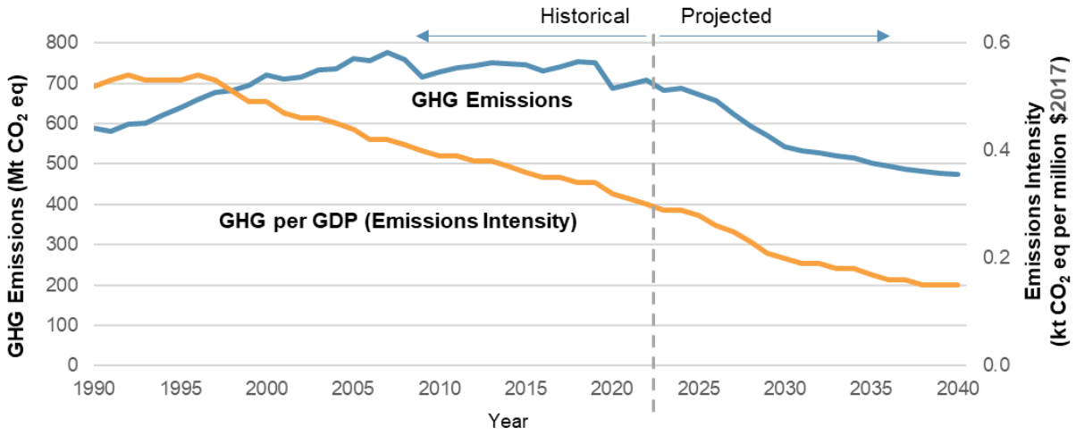
Canada’s Road Towards 2030
Canadian GHG emissions and indexed trend emissions intensity excluding LULUCF, NBCS, and agriculture measures, WAM scenario, 1990 to 2040

Slide 17

Indicator Gaps
Many indicators at the sectoral level rely on historical emissions data from the annual national inventory report (NIR) to show whether progress had been made
There is a 16-month time lag in publishing inventory data, e.g. 2025 report presents data for 2023
Accessing timely data
Audit finding: Not the most effective tool for quickly monitoring progress and course correcting

Slide 18
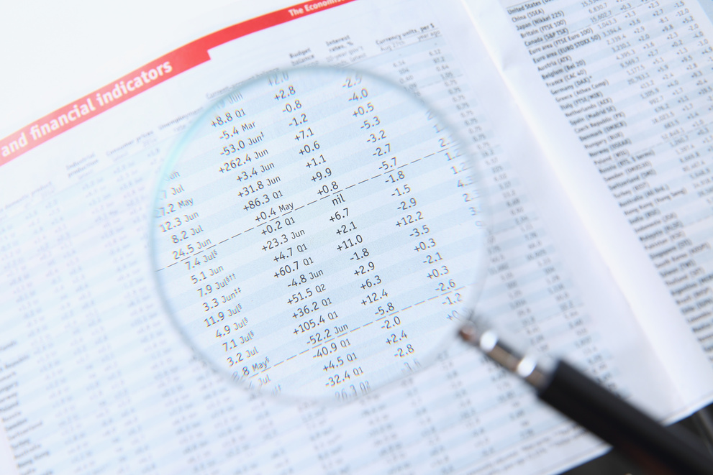

Sector-Level Secondary Indicators
Using secondary indicators was recommended by the Commissioner of the Environment and Sustainable Development, who provides independent analysis and recommendations on the federal government’s efforts to protect the environment, mitigate the effects of climate change, and foster sustainable development.
Objective: To capture timely insight into trends and results of climate actions across the Canadian economy, and to reflect the efforts of government, civil society, businesses, and households to meet Canada’s climate goals.
Planned framework: 2-3 indicators per sector, drawing from existing, publicly available data.
To be included in the 2025 Progress Report on the 2030 ERP, and subsequent reports.

Slide 19
Sector-Level Secondary Indicators
Examples
Indicators
Desired Outcomes
Percentage of heating systems that are heat pumps in residential buildings
Increase in the number of heat pumps in Canada’s residential buildings to improve energy efficiency and reduce emissions from residential homes
Buildings
Proportion of electricity generated from renewable and non-greenhouse gas-emitting sources in Canada
Electricity
Canadians have access to clean and renewable energy
Transportation
Light-duty zero-emission vehicle (ZEV) market share (percentage of new sales)
Accelerate the switch to zero-emission on-road vehicles to reduce emissions from on-road transportation

Slide 20

Still...
We try to draw from the many existing indicators and reporting frameworks (e.g., UN SDGs, FSDS, Departmental Results Reports, etc.) rather than creating new ones - but not always suited to our needs
Developing secondary indicators is challenging
Many data have a two-year lag or more
Data frequency varies (not all available on a yearly basis, e.g., surveys)
Work is underway in collaboration with other federal departments to identify the best indicators with the most recent data available to show progress in each economic sector

Slide 21

Next Steps
Finalizing the list of secondary indicators
Oct 2025
Release of the:
  2025 Emissions Projections
  2025 Progress Report on the 2030 ERP
Dec 2025

Slide 22

Thank you!

